Slide 1


Presented By: Rejey Ezekiel (2348935)
Job Stability
ST1510 Programming for Data Analytics

Slide 2

Problem Statement
To what extent does the worlds economy affect/influence Singapore's job markets?

Slide 3

Datasets
Gross monthly income from work of resident employees (df_Employment_Rate_SG)
global database of inflation (df_world_infaltion_dataset)
GDP of available countries (df_country_GDP)
Statistics of unniversity graduates (df_UNI_Graduates)

Slide 4


Exploratory Data Analysis

Slide 5
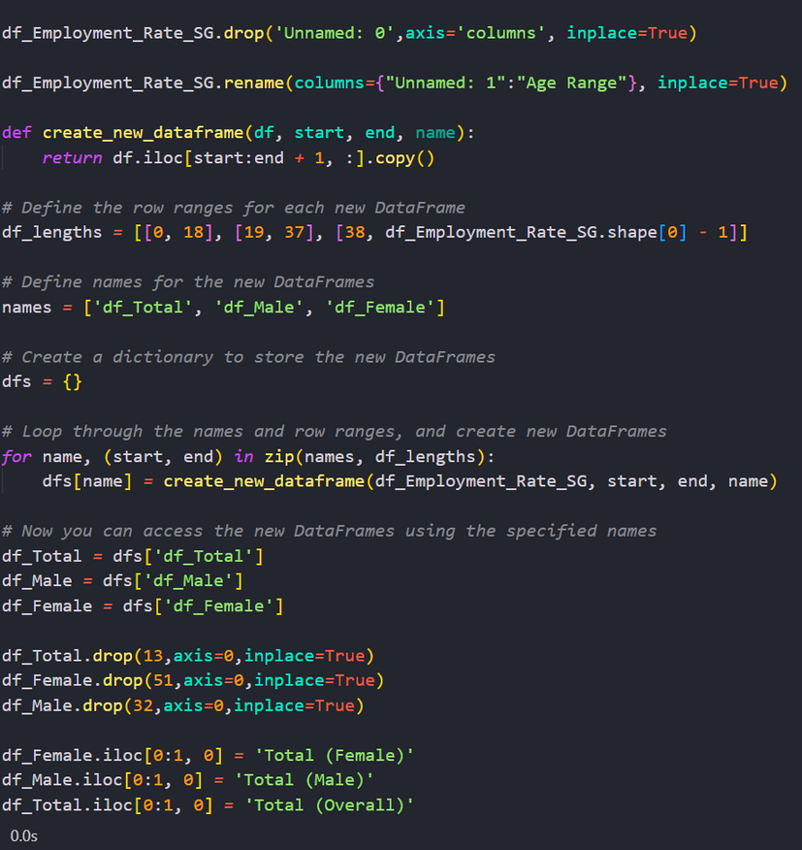
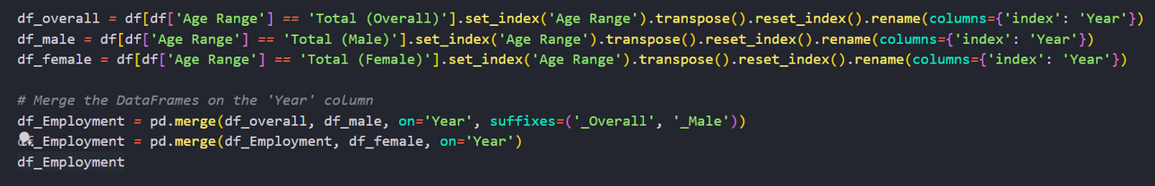
Employment Rate (df_Employment_Rate_SG)
Key Details About the dataset:
The dataset was imported from a excel workbook thus needed a lot of cleaning to retrieve the information.
Instead of manually typing the columns/rows to filter it i wrote a function to do it so i can view the data easily

Slide 6
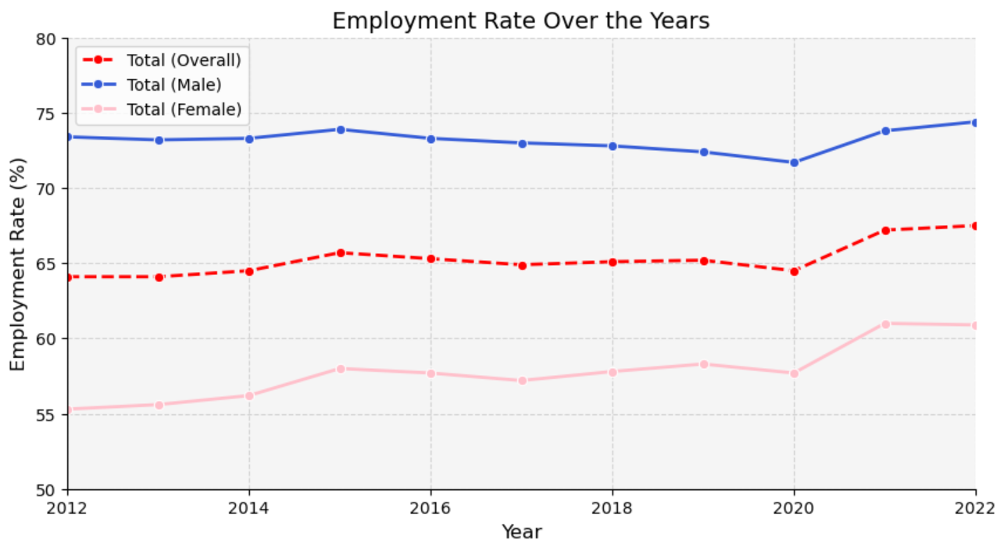
Findings
More males were employed over females and around 67.5 of Singaporeans were employed in 2022, reflecting Singapore's ageing population.

Slide 7
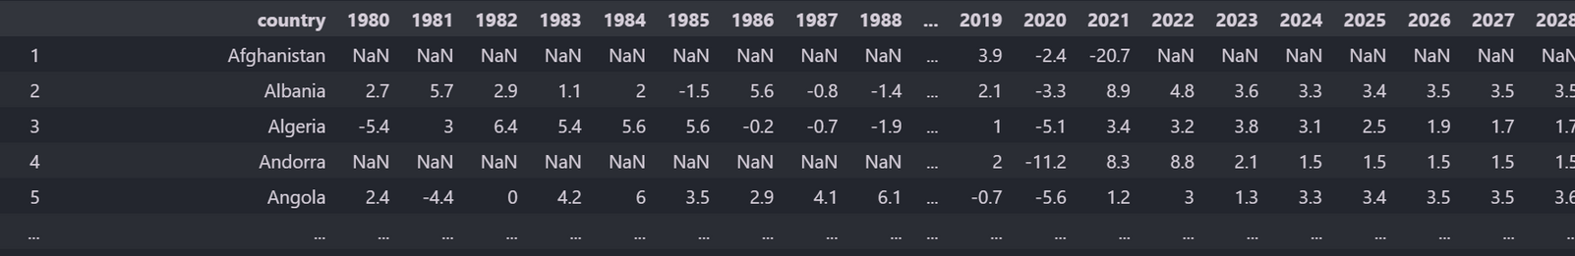
GDP of available countries (df_country_GDP)
Key Details About the dataset:
Dataset came with a lot of NaN values as they were not able to get the countries GDP for that year.
The countries is the dataset were in a row, being a little harder to manipulate.
The data set also had data from 1980 to 2023 but many of the countries had missing values.

Slide 8
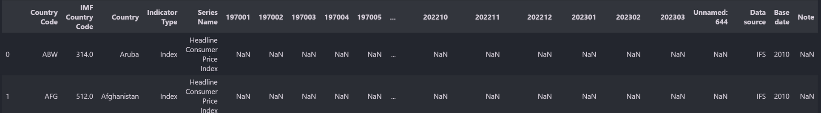
global database of inflation (df_world_infaltion_dataset)
Key Details About the dataset:
The key issue about this data set is that the years are labelled in a (yyyymm) format making it more harder to user and manipulate data inside.
This dataset also had many columns of data that could be dropped like Country Code, IMF Country Code.

Slide 9
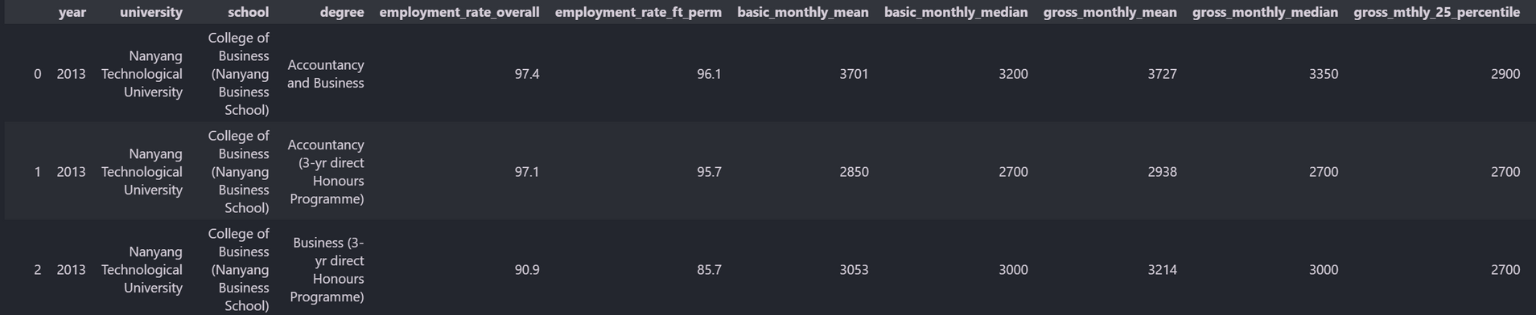
Statistics of unniversity graduates (df_UNI_Graduates)
Key Details About the dataset:
It has many columns from monthly starting salary, but i was more interested in the employment rate for certain degree and schools.
The issue with this data set is that the names for degrees and schools could vary.

Slide 10
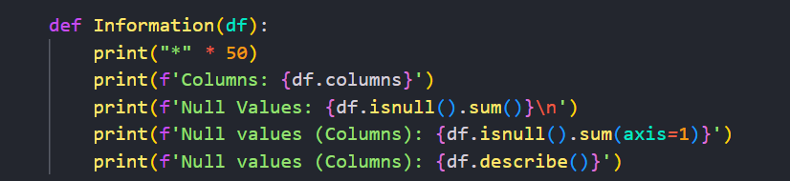
Data Wrangling
01. Before Performing any data Wrangling it is important to know what the dataset and some key information.
02. I have create a Function here in python to do so, This function returns key information of dataframes and prints out details like the columns, null Values and whether its numeric or not.

Slide 11

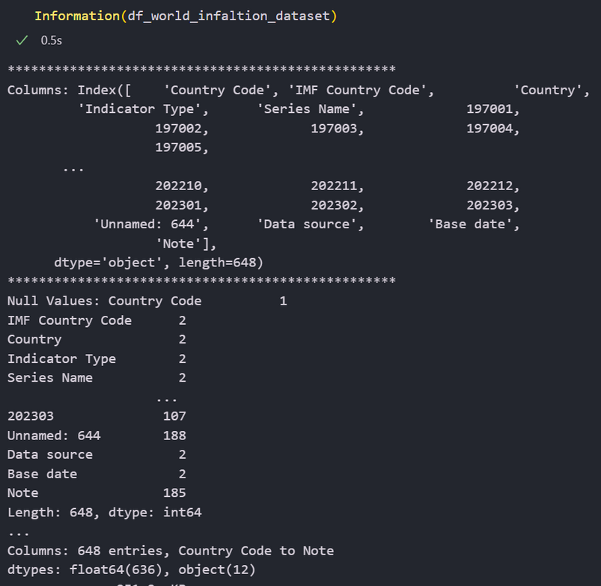

Dataset Information
Its Always important to also understand the datasets information as not all data can and will be a integer or float.
Therefore using .info in pandas allows us a quick way to view the datatypes used in the dataset.
with this i was able to view that many of my dataset even though haaving floats at face value was stored as objects.

Slide 12

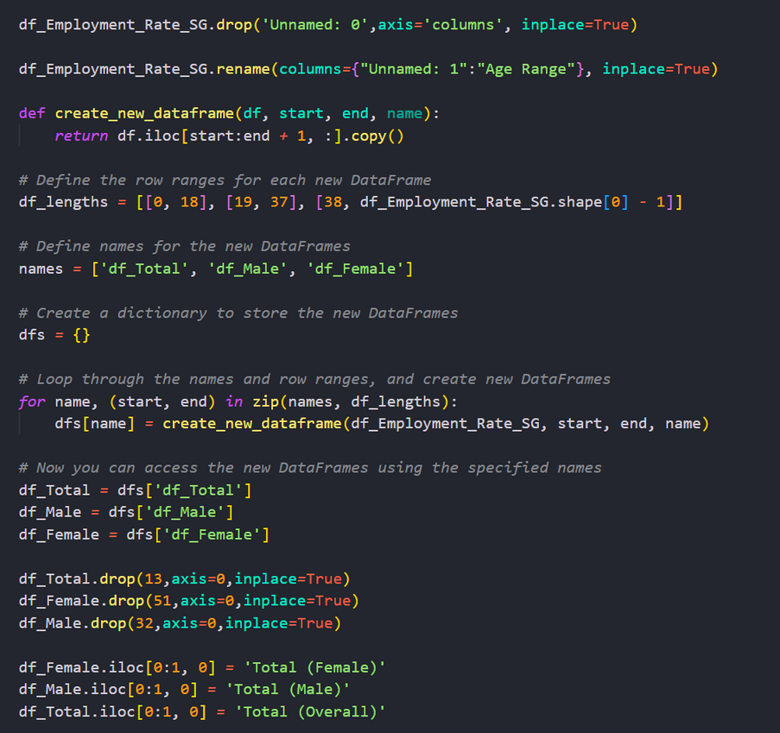

Cleaning the dataset
Starting with my first dataset about employment in singapore, i had to do some intense cleaning as the way the data was potrayed in a dataframw was bad as it was from a excel notebook, so i created a function to deal with it. where i skipped certain points and renamed the bigger dataset into sub dataset with each Male,Female and total

Slide 13

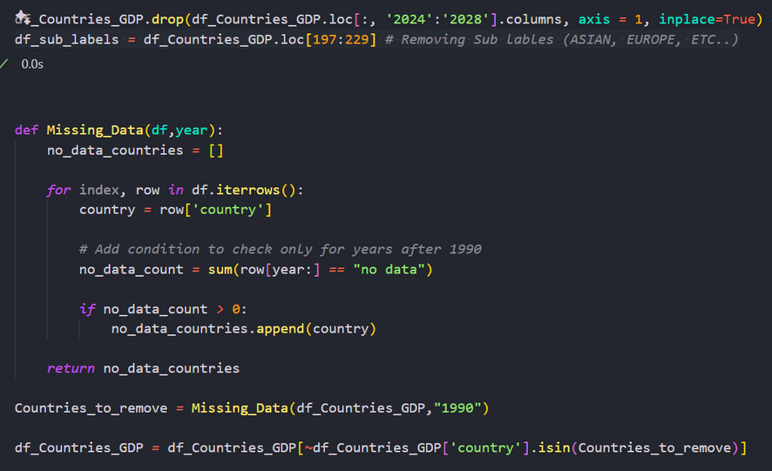

Cleaning the dataset Pt 2
I wrote a script here to see wether i should keep or remove a coutry based on how much missing data they have.
I also had to remove years 2024 to 2028 as this data set had predicted values.

Slide 14

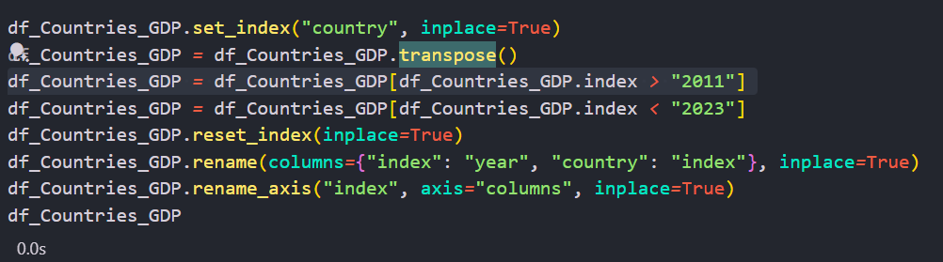
Transposing the dataset to fit

Slide 15
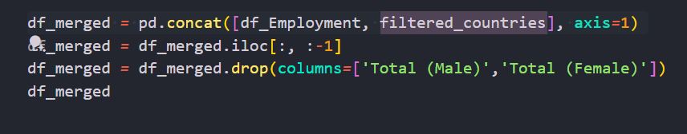
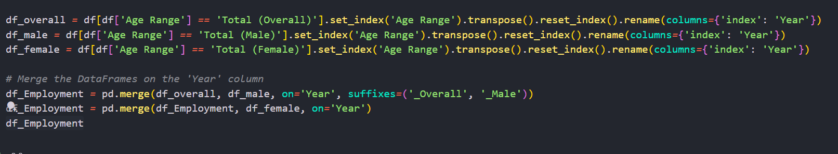
Merging the Datasets Together
Firstly i merged together the Employment dataset after separating them
Next i merged together the GDP Countries dataset together with the employment dataset.
This caused me alot of problems as the structure of both datasets were different and had to transpose the dataset to concat them

Slide 16
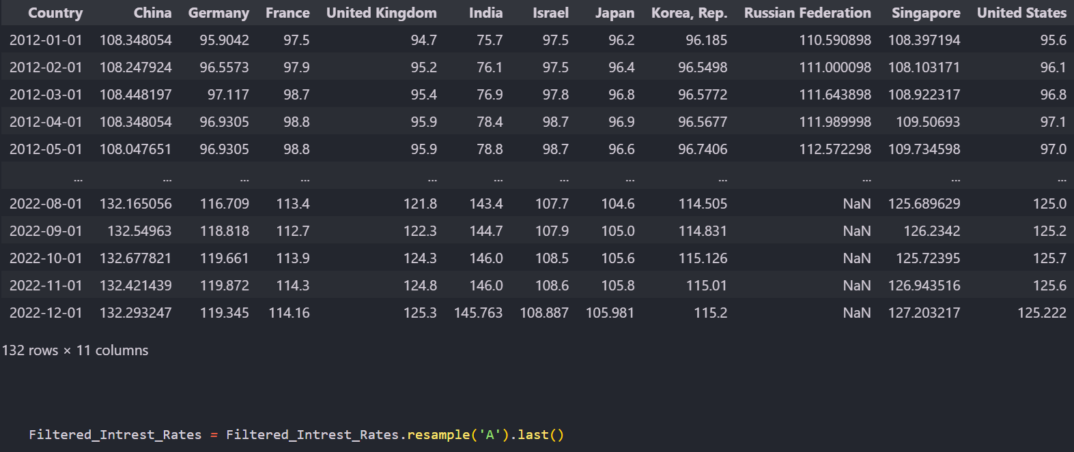
Data Transformation

Slide 17


Graphing

Slide 18
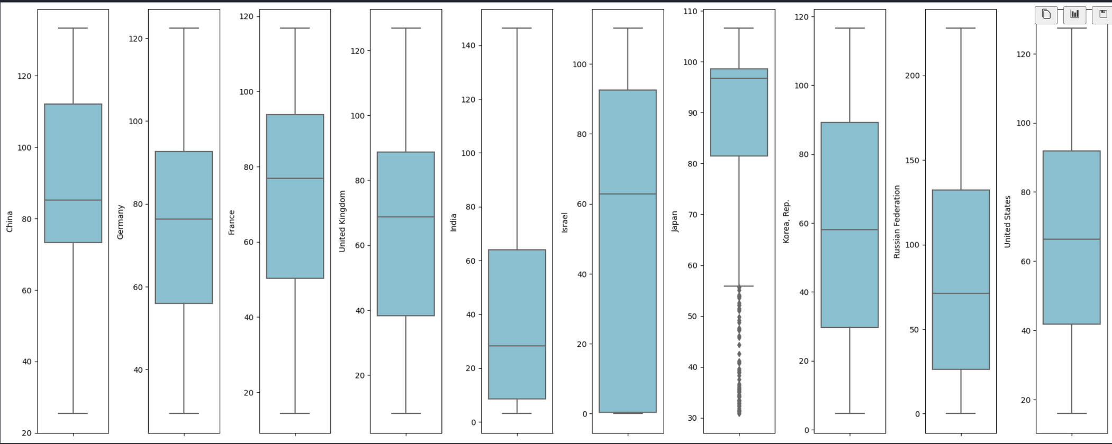
Distribution of countries GDP

Slide 19
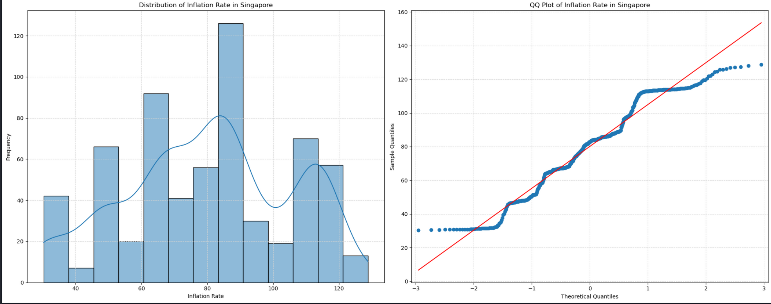
Normality of Singapores GDP

Slide 20
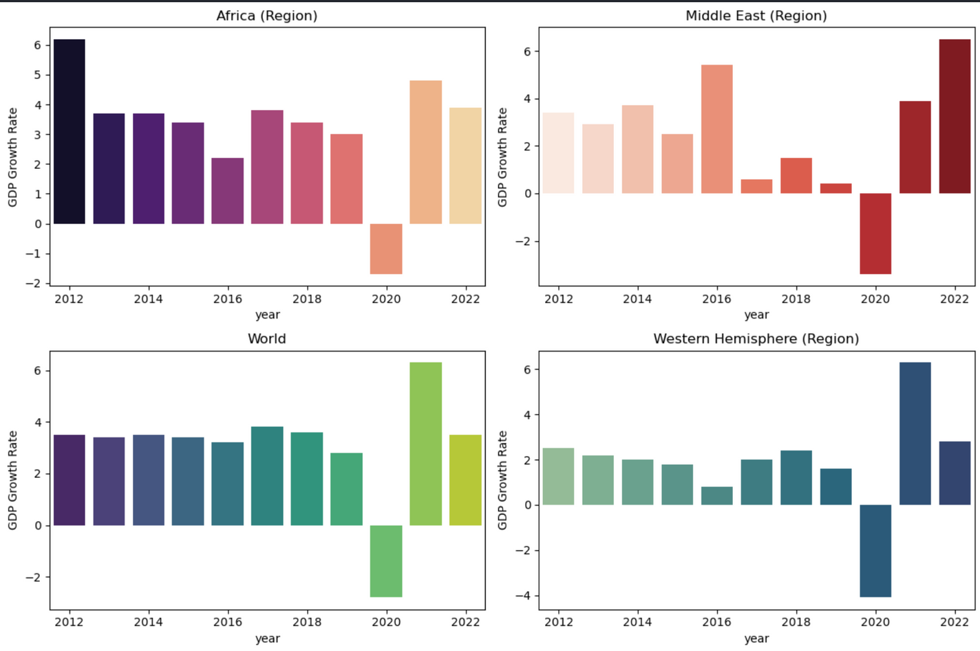
GDP Growth of 4 Countries

Slide 21
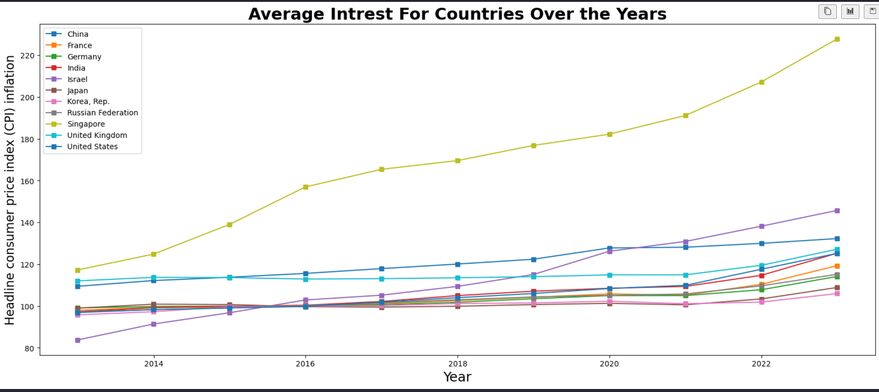

Slide 22
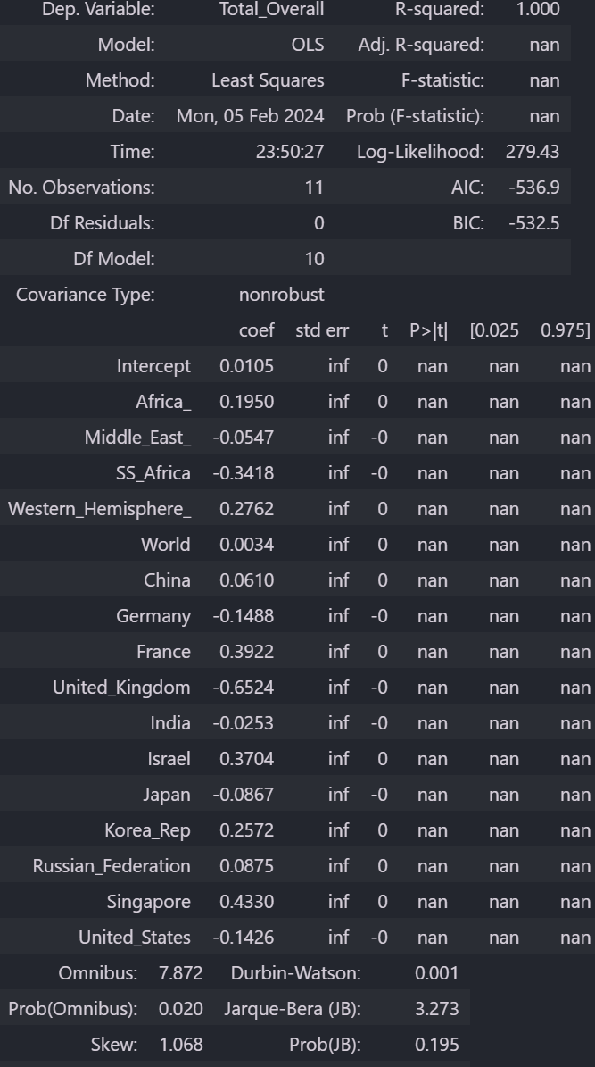
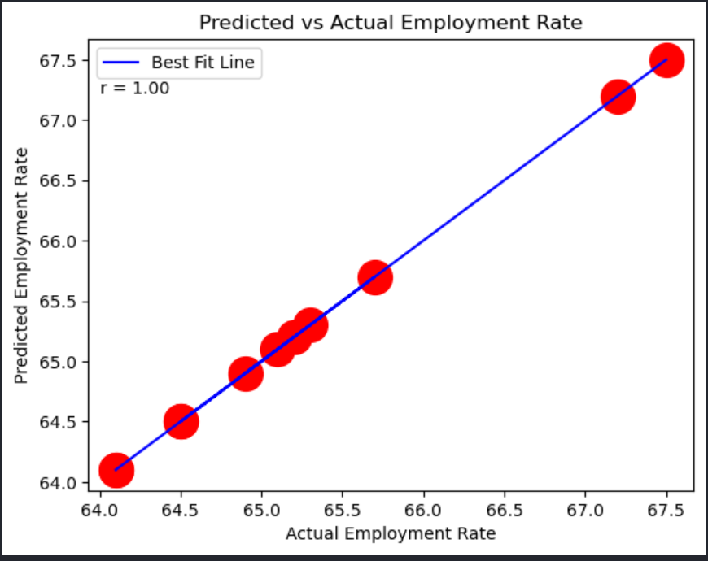

Slide 23
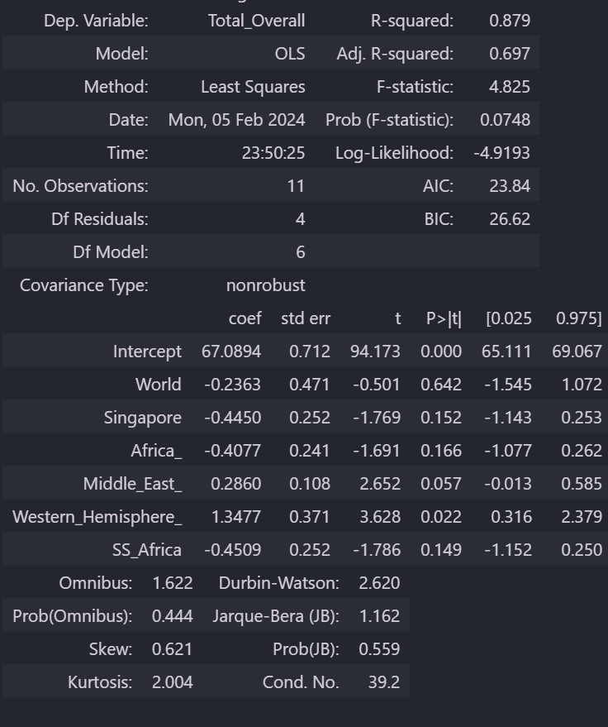
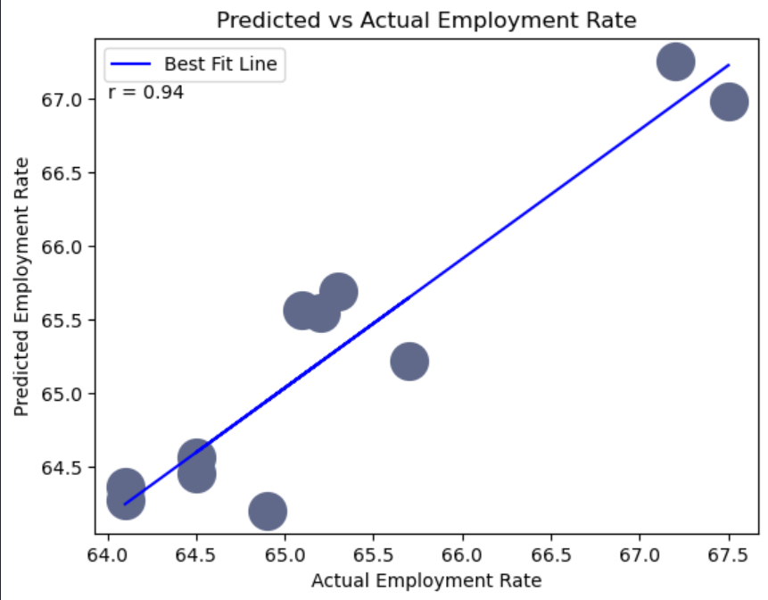

Slide 24
Conclusion
In conclusion i can see that GDP and Infaltion Rates worldwide Affect singapores employment rate drastically, showing that singapore is heavily infulenced by external facotrs not limited to the ones i have displayed but can be in relation or caused to affect GDP and Inflation.

Slide 25

Presented by Rejey Ezekiel
Thank you very much!

